Slide 1

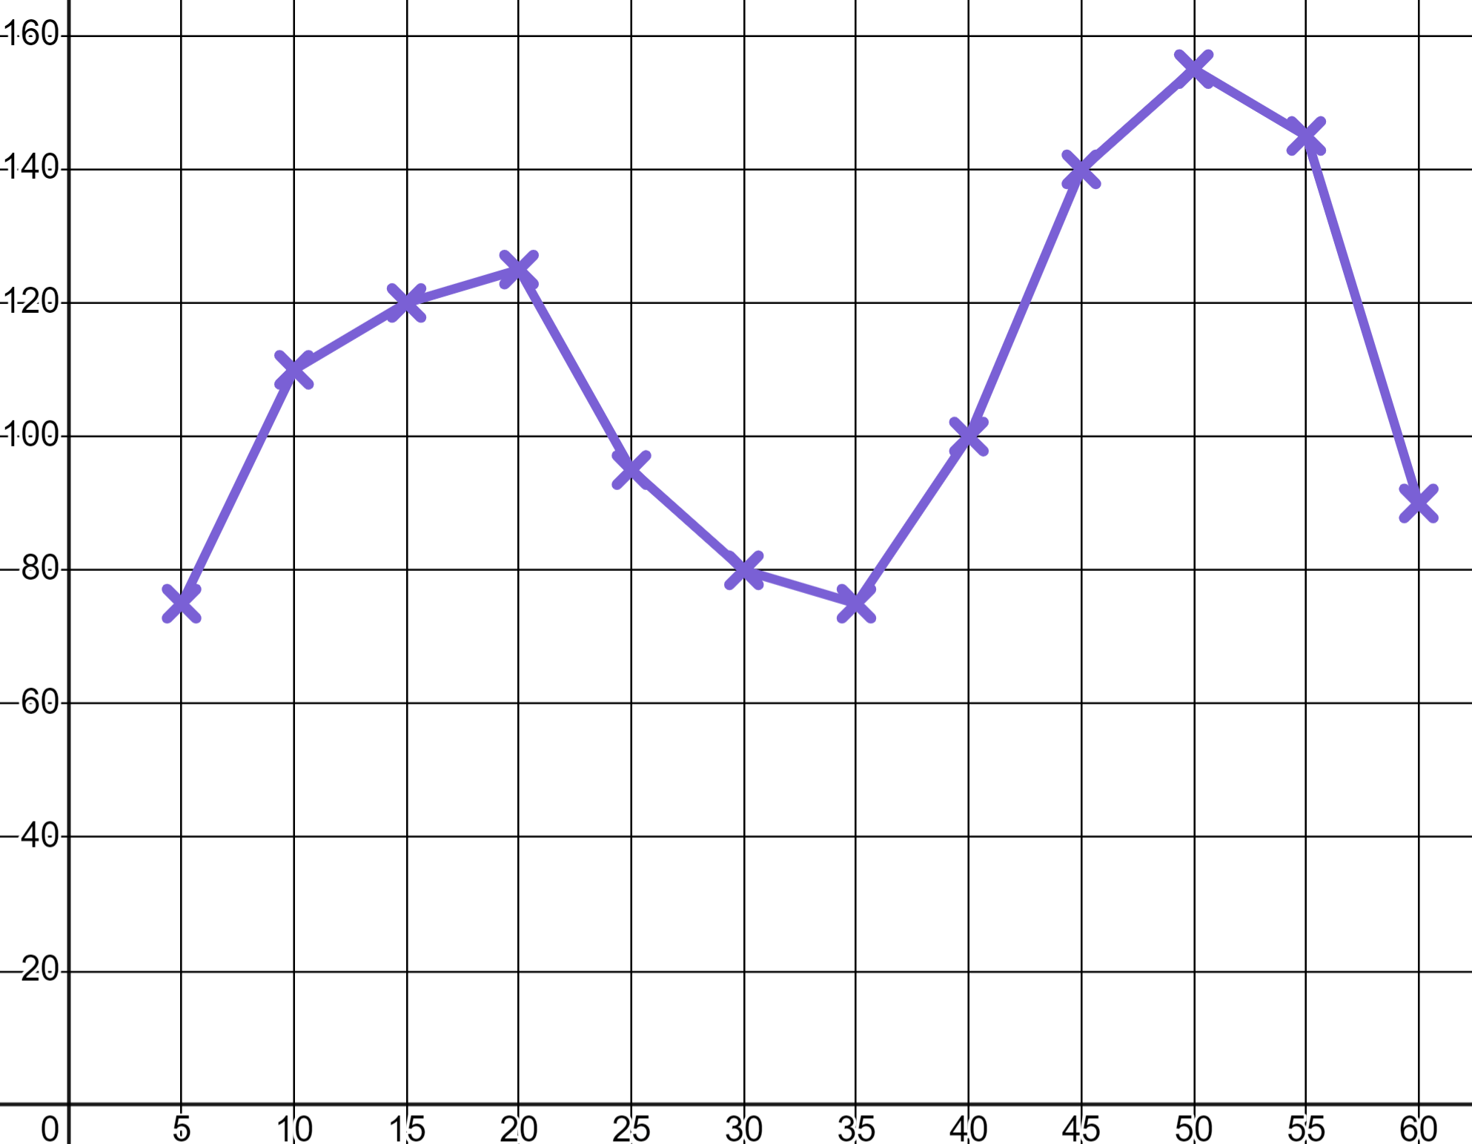
Sports coaching
Task A: Recording and using data
1) a) Jacob goes skateboarding and his watch records his b.p.m.
Write at least three sentences to describe Jacob’s skating session. Use words like ‘moderate intensity’ and ‘high intensity’.
b.p.m.
T (min)
b) Rank these three moments with a numerical value from the trainers’ RPE chart.
RPE Chart (Rate of perceived exertion)
10 | Max effort | Impossible to continue Out of breath Unable to talk
9 | Very hard | Hard to maintain Can barely breathe Speaking single words
7-8 | Vigorous | Verge of uncomfortable Short of breath, single sentences
4-6 | Moderate | Could continue for hours Breathing heavy, short conversation
2-3 | Light | Easy to maintain for hours Can maintain conversation easily
1 | Very light | Anything other than sleeping e.g. Sitting watching T.V.
b.p.m.
T (min)

Slide 2


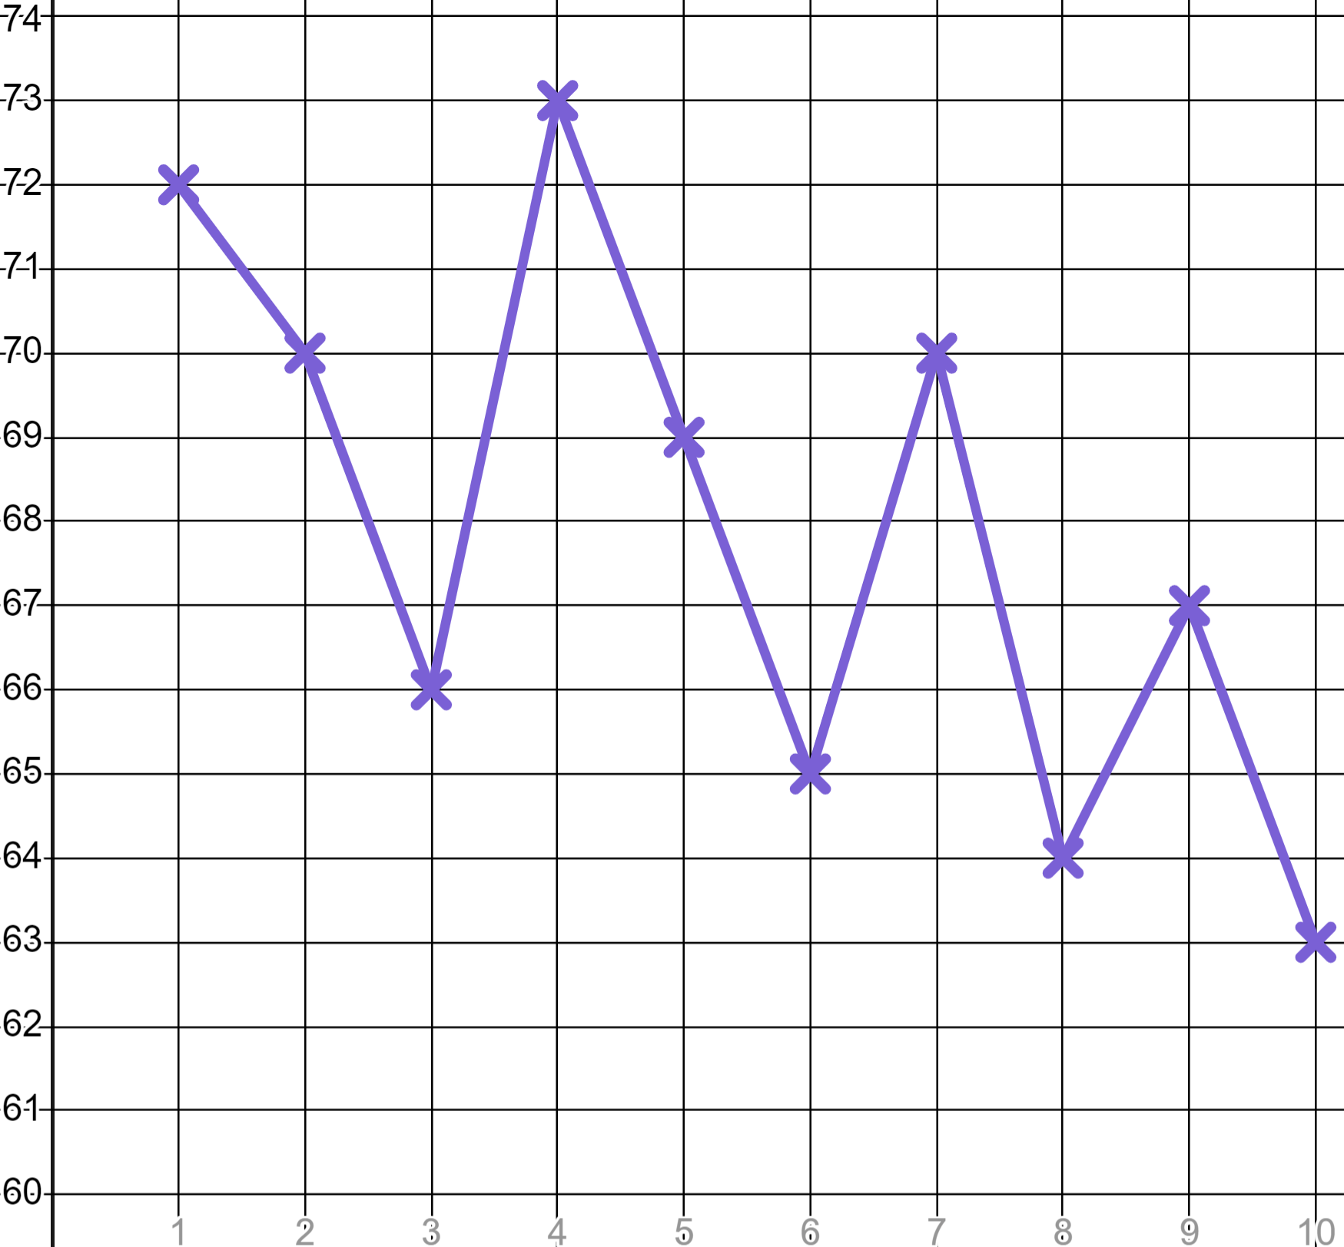
Sports coaching
2) Sporty Sofia is filling in a target heart rate chart for older members of her family to use whilst exercising.
Your maximum heart rate is 220 b.p.m. minus age
Target heart rate for moderate exercise is 50 − 70% of maximum
Target heart rate for high intensity exercise is 70 − 85% of maximum
Age | Moderate exercise min | High intensity starts | High intensity max
20 | 100 | 140 | 170
30 | 95 |  | 161.5
50 |  | 119
 |  |  | 127.5
Fill in the blanks in the table.
3) Aisha is trying to improve her 400 metre time. Here are her best times over 10 weeks of training.
Week | 1 | 2 | 3 | 4 | 5 | 6 | 7 | 8 | 9 | 10
Time (sec) | 73 | 70 | 66 | 73 | 69 | 65 | 70 | 64 | 67 | 63
Athletic Aisha
a) Calculate the mean, mode and median of her times.
b) Write a sentence explaining why these three averages alone do not inform you as to whether Aisha is improving.
c) Populate the table of three-point moving averages (to the nearest whole number). The first one is done for you.
Week | 1 | 2 | 3 | 4 | 5 | 6 | 7 | 8 | 9 | 10
Time (sec) | 73 | 70 | 66 | 73 | 69 | 65 | 70 | 64 | 67 | 63
 | ✖ | 70
d) Graph Aisha’s three-point moving averages and write a comment as to whether she is improving.
Time (s)
e) Use your three-point moving averages to make a prediction as to when Aisha might break the 60 second barrier.
Wk

Slide 3
Sports coaching
Task B: Using data to plan training sessions
Training Goal | Sets | Reps | Rest Period | Intensity
Endurance | 3 - 4 | > 12 | Up to 30 seconds | < 67% of 1RM
Muscle leanness | 3 - 6 | 6 - 12 | 30 to 90 seconds | 67 - 85% of 1RM
Muscle strength | 4 - 6 | < 6 | 2 to 5 minutes | > 85% of 1RM
1) Sofia’s older brother is training for a heptathlon therefore he needs to develop muscle leanness. He is working on his bench press and has a 1RM of 80 kg. Create for him a:
a) Starter plan
b) Improver plan
c) Expert plan
2) a) Someone with a 1RM of 125 kg in deadlifting is doing reps of 76 kg. What is their training goal?
b) Someone tells you they did 60 repetitions across all of their sets. What could their training goal be?
c) Someone tells you they are intensely training for muscle leanness and are deadlifting 136 kg. What is their 1RM?
Mathematics in Education and Industry
v2.4

